Slide 1
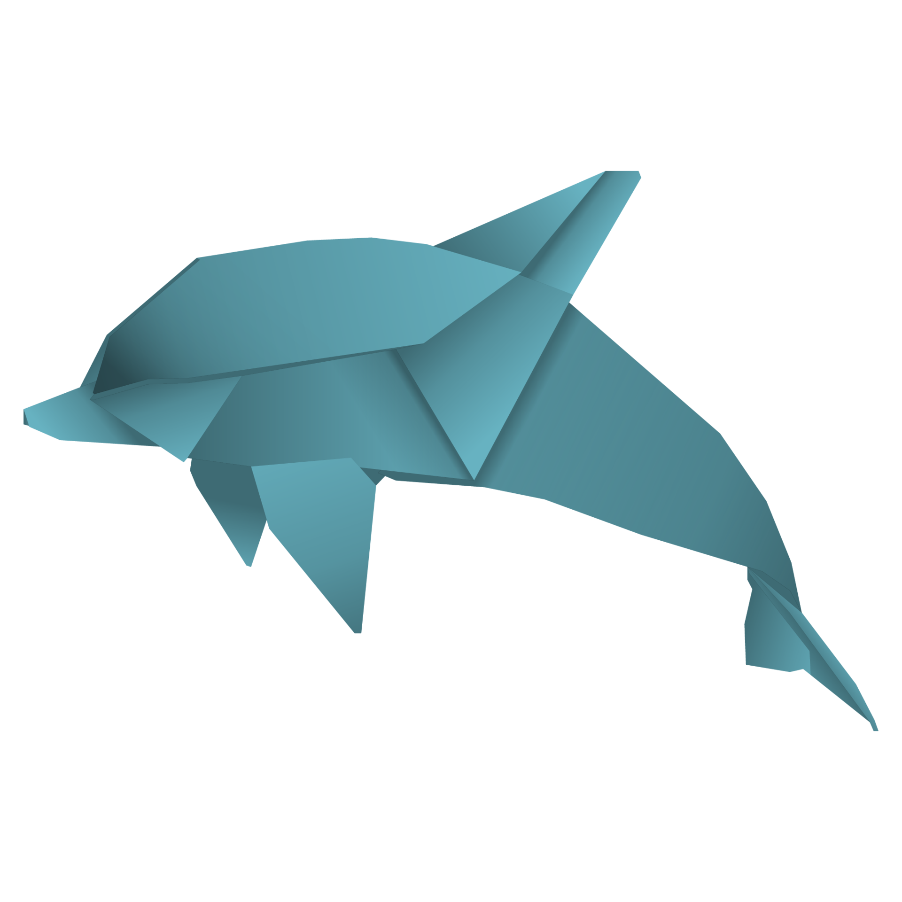
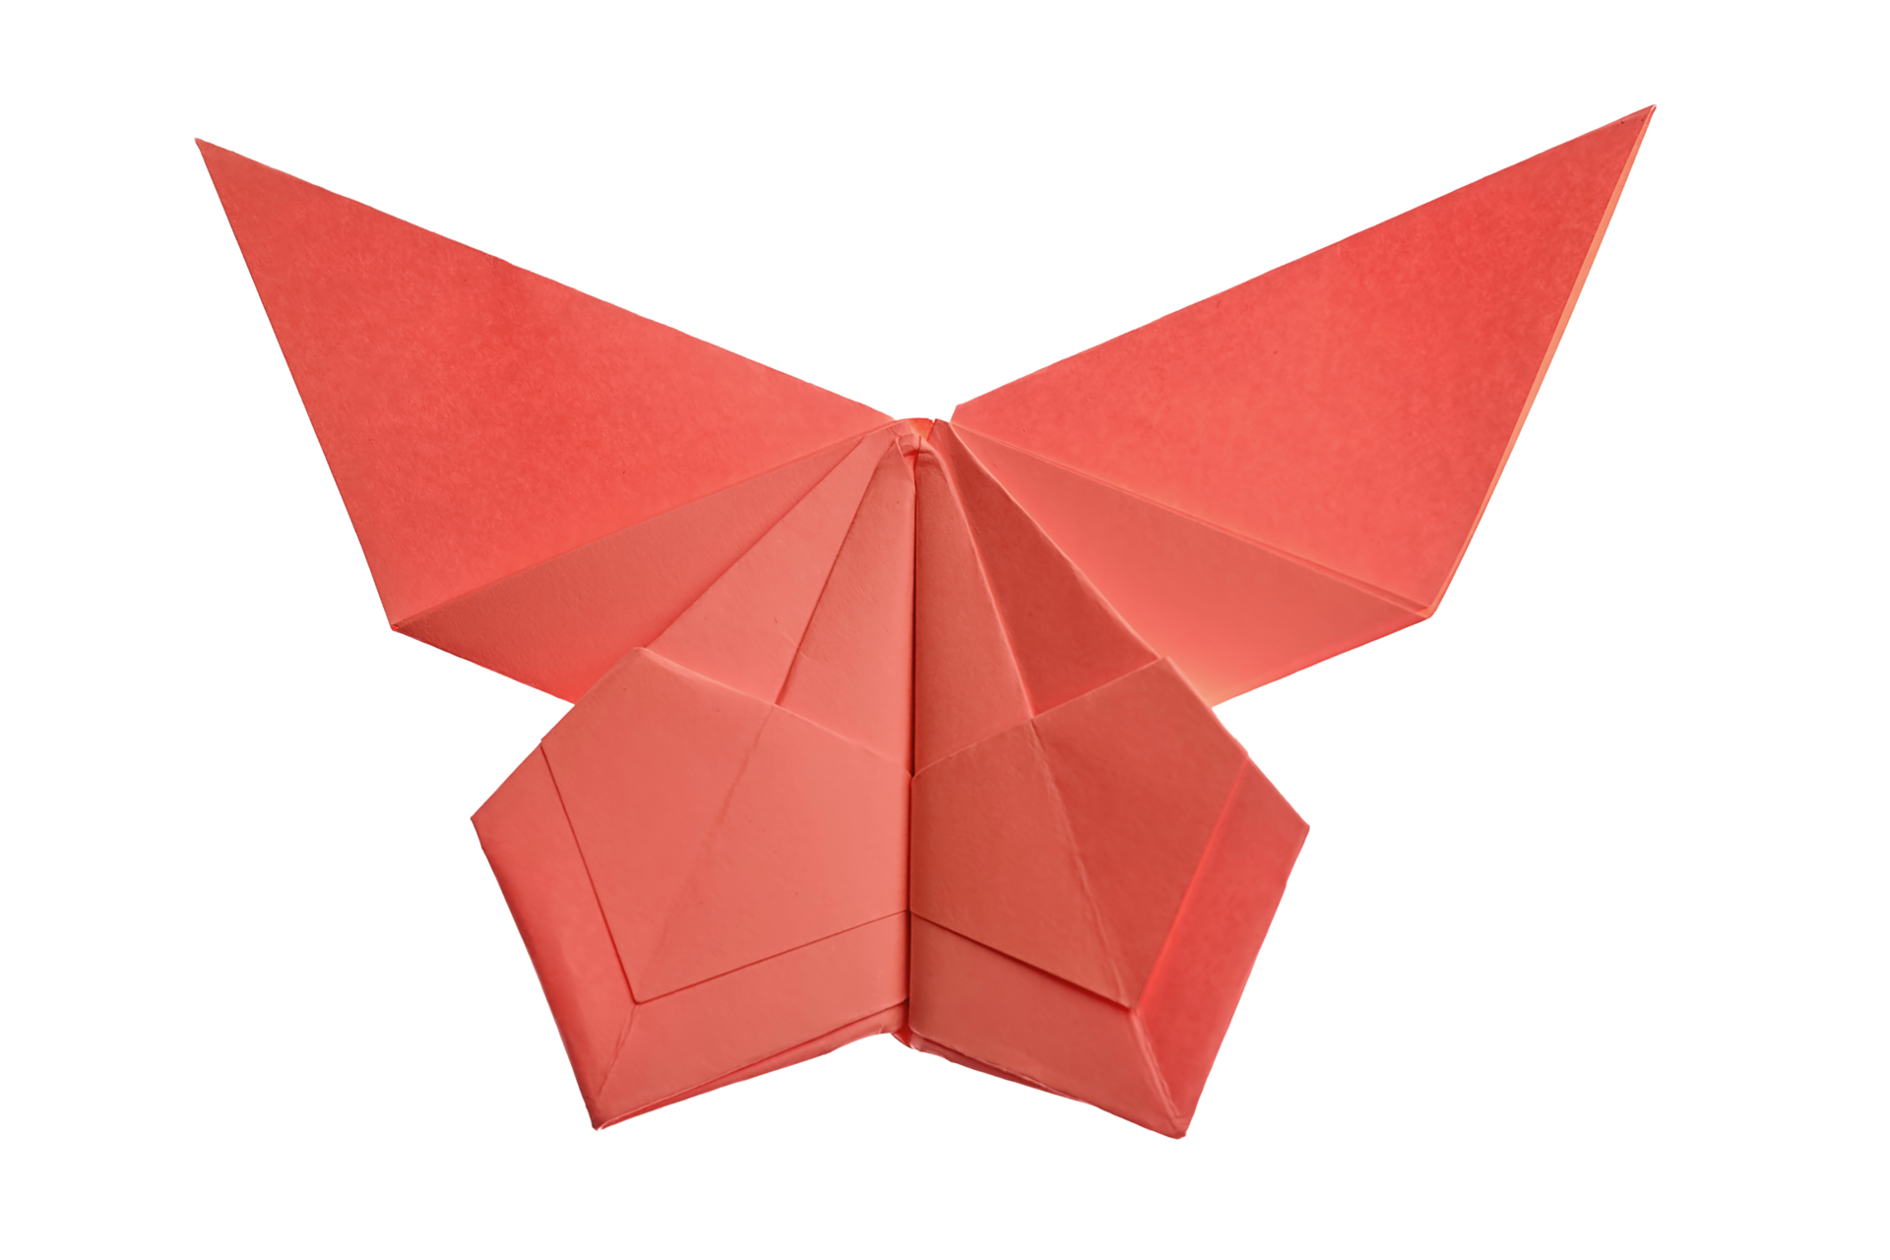
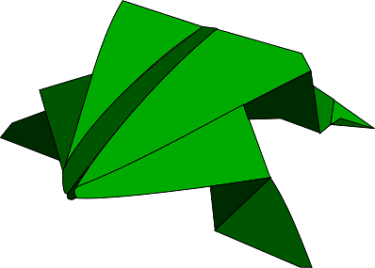

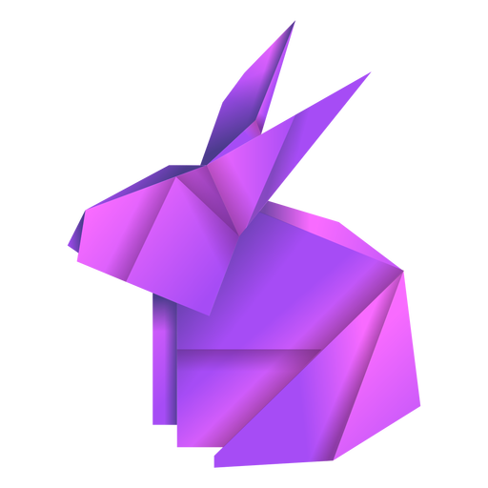
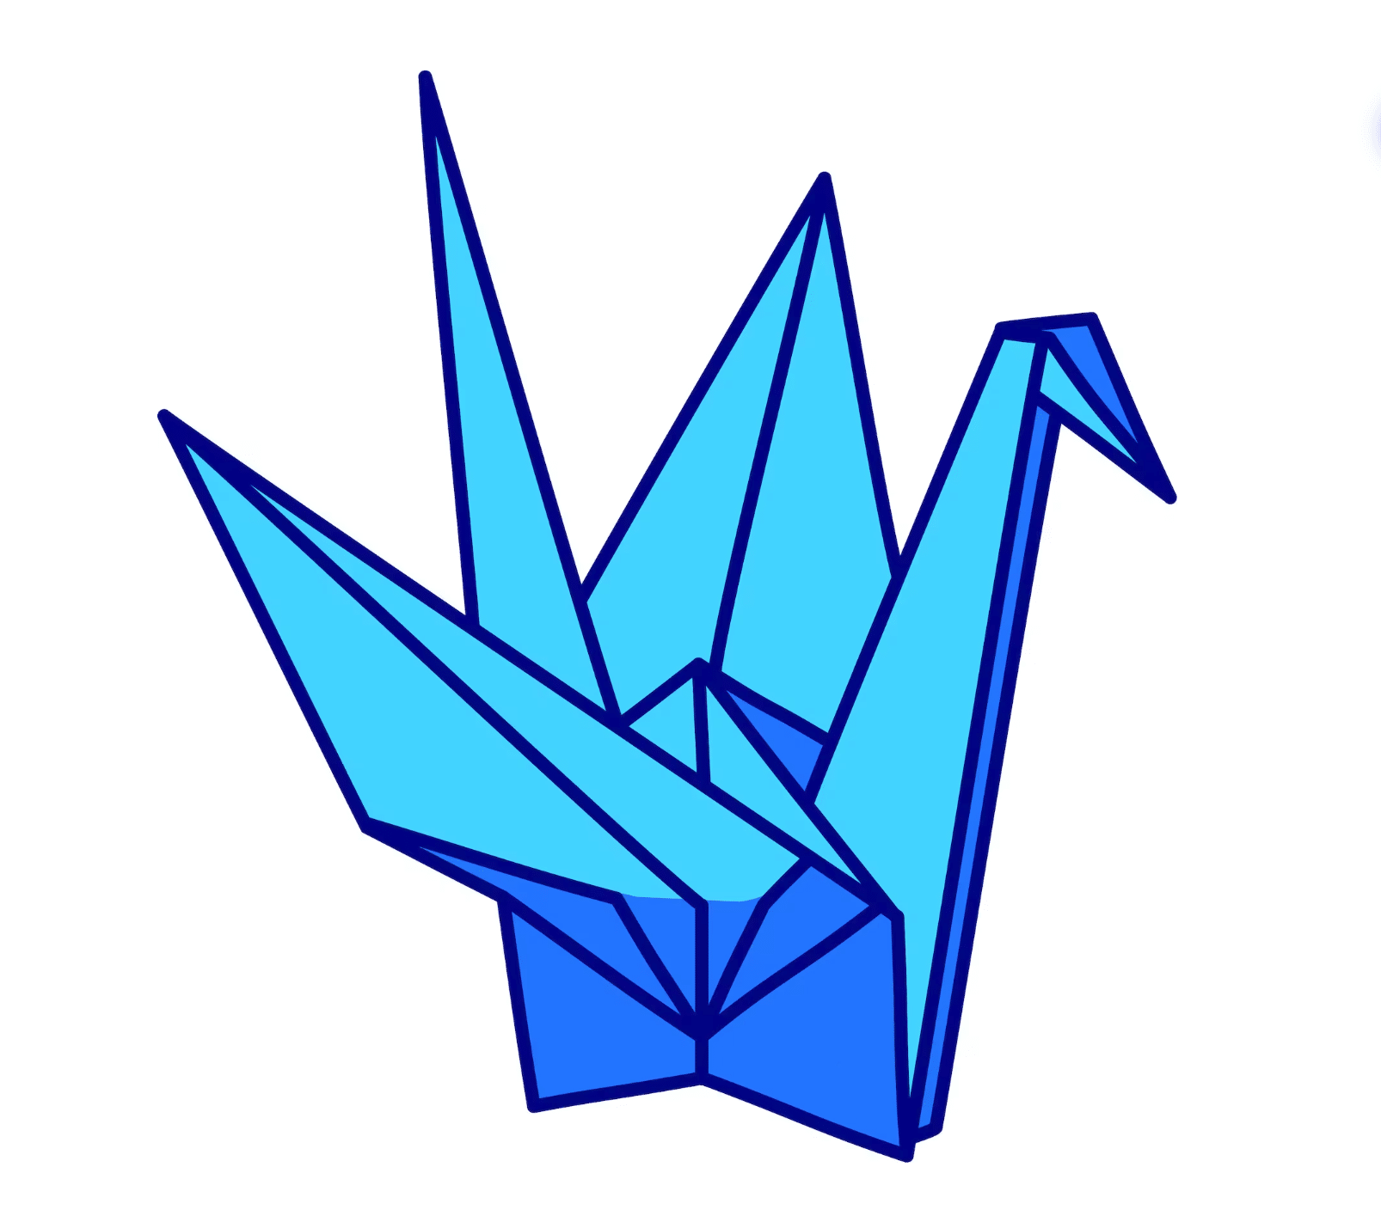

Slide 2
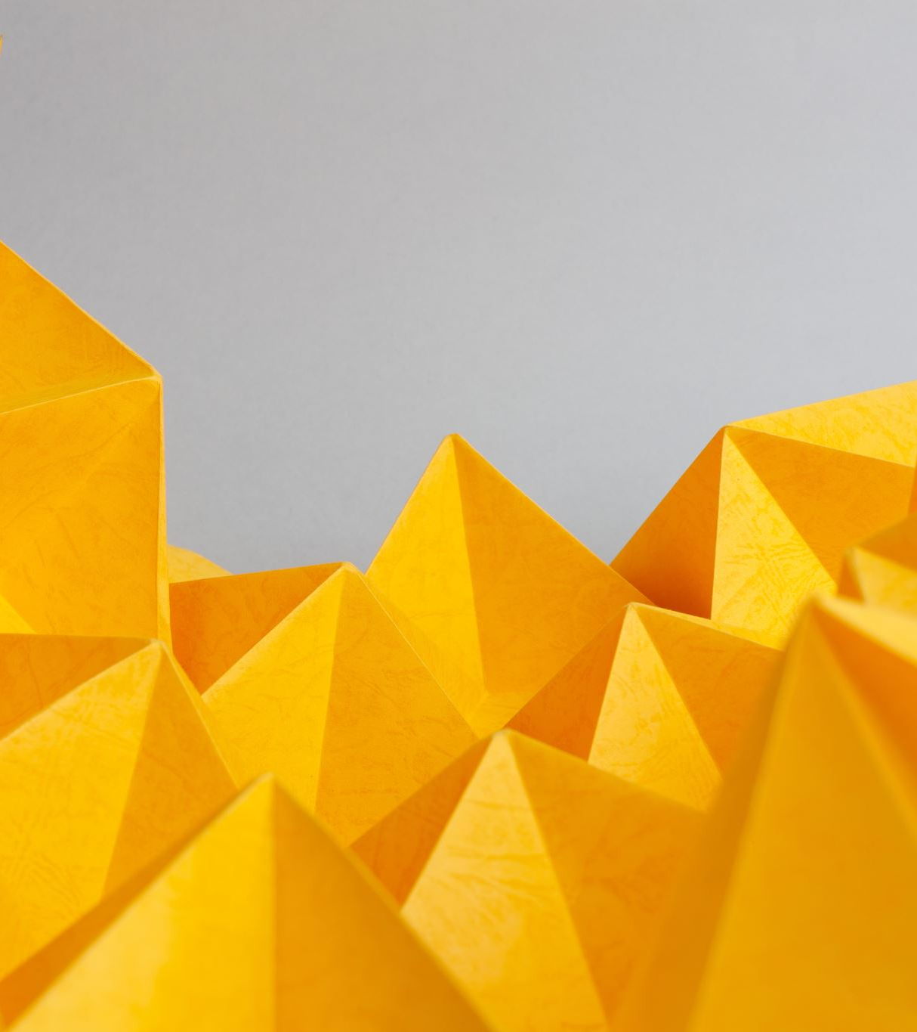
What is Ori(go)?
Origo can potentially be a cloud-based database of unique origami designs. These Origami structures are based on real world creations that can be digitally “unlocked” to possess the digital artifact.
The Origo structures will be animated and will be produced from a crumpled piece of paper to a flat piece of paper to the desired/ unlocked Origami structure
Origo will likely be a web devolped project where Origami structures will be based on Orgs which will have a value dependent on the difficulty and determined time taken to make a structure

Slide 3
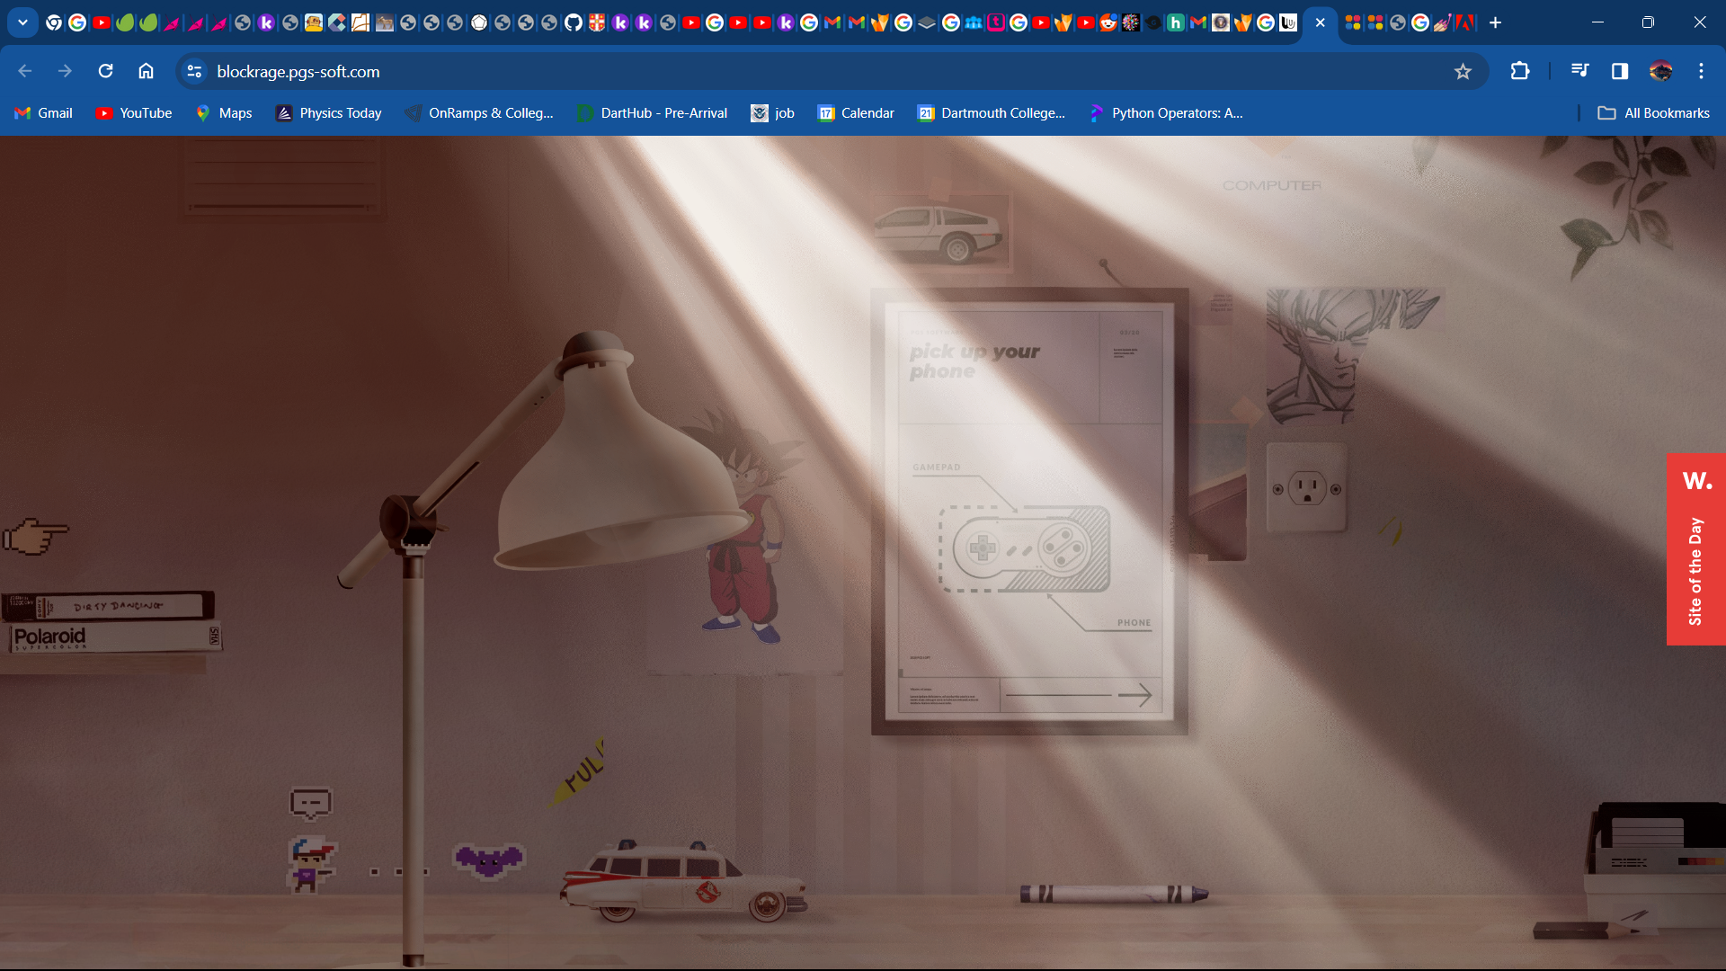

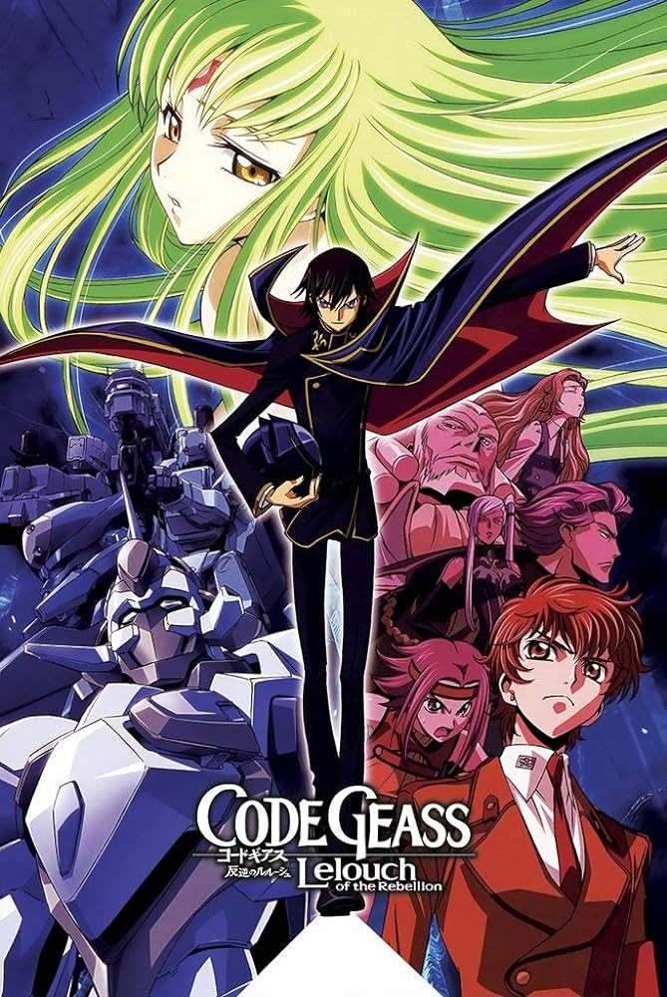
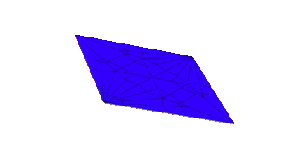
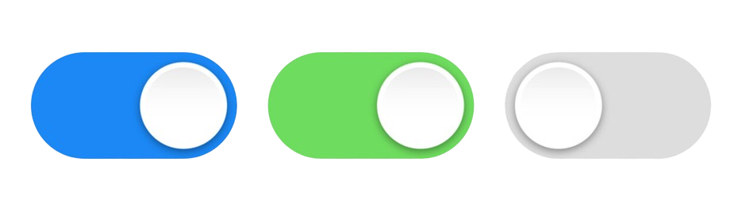
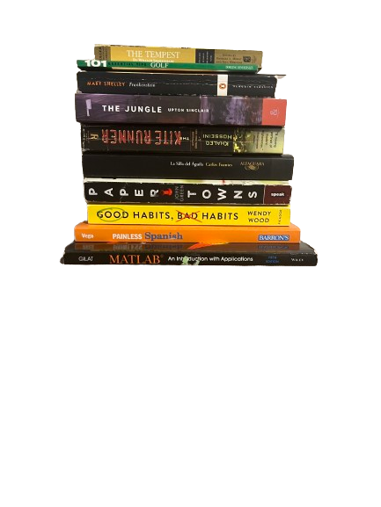
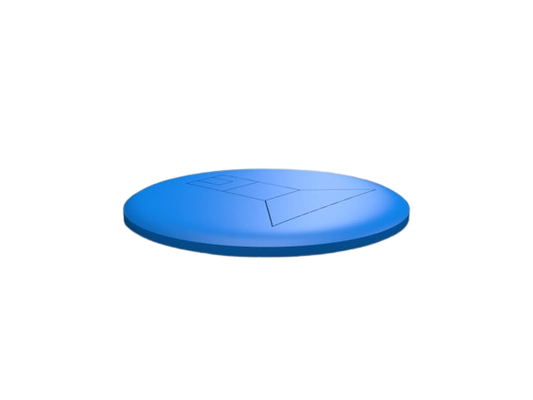

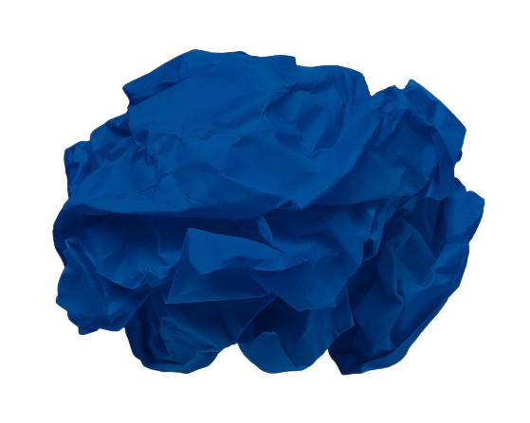
Model prototype
65
Structure: Crane
Model Number: 13592940EDEEEF30
Description: Abstract crane model with pyramid base
Difficulty: Moderate
Time Spent: 5 mins
Orgs: 65

Slide 4

Features
Blue button allows user to double tap piece of paper to result in the suspended animation
The hover feature is activated with the green toggle button
The grey far right button is based on an allowance to either move the crumpled piece of paper on or off the platform

Slide 5
+ Features
In the beta release there will be at least 3 crumpled up pieces of paper of different colors.
The models for the structures will include an origami crane (3D), the lang cardinal model and the origami crane (flat)
Unique systematic features include the 3rd toggle feature representing whether the crumpled paper is on the platform or not (toggle to the right is on and toggle to the left is off)

Slide 6

Pitch
If An Idea exists online, it is timeless.
With the advent of technology, AI, and machine learning, we have entered the technological age
Origami, simple in nature but imbued with mathematical design and symmetry based on the deconstruction of a 2d object to a 3d object allows people to rekindle their desire for geometry in motion
Design and the art of folding paper once thought to be ancient and obsolete has been remodeled to encompass ingenuity and sophistication.

Slide 7
Tasks in order
Solidify Database based in R to a csv
Solidify website design based on the 3 crumpled models
Produce toggle features for the 3 models
Provide hover feature text for other two models
Produce click, hover, and return feature for the 3 models
Give the website an official domain
Finalize currency description and trademark names
Work on copyright feature
Include more features and finalize PowerPoint
Put on resume
Tweak project---

Slide 8
UNFINISHED

